Slide 1
Neural Radiance Field with Refraction
Zhangkaiwen Chu

Slide 2
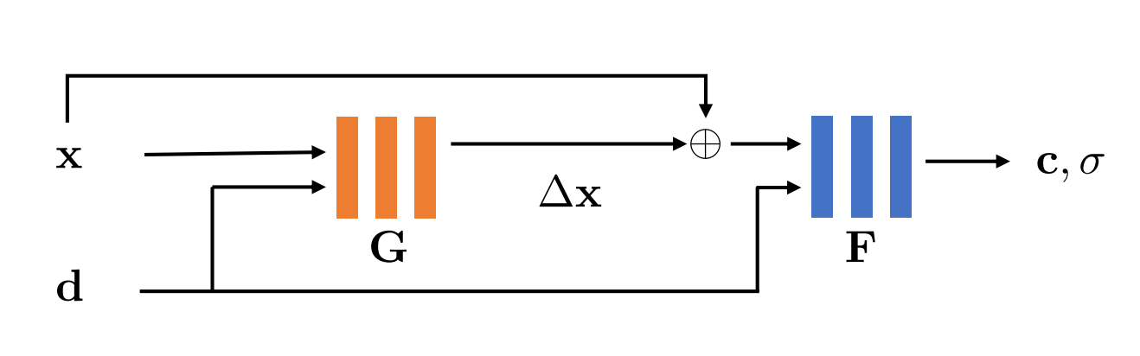
Overview
Neural Radiance Field assumes light travels in a straight line, so it is bad at learning specular and refractive effect.
IB-NeRF use a neural network to learn an offset field to model the light bending.

Slide 3
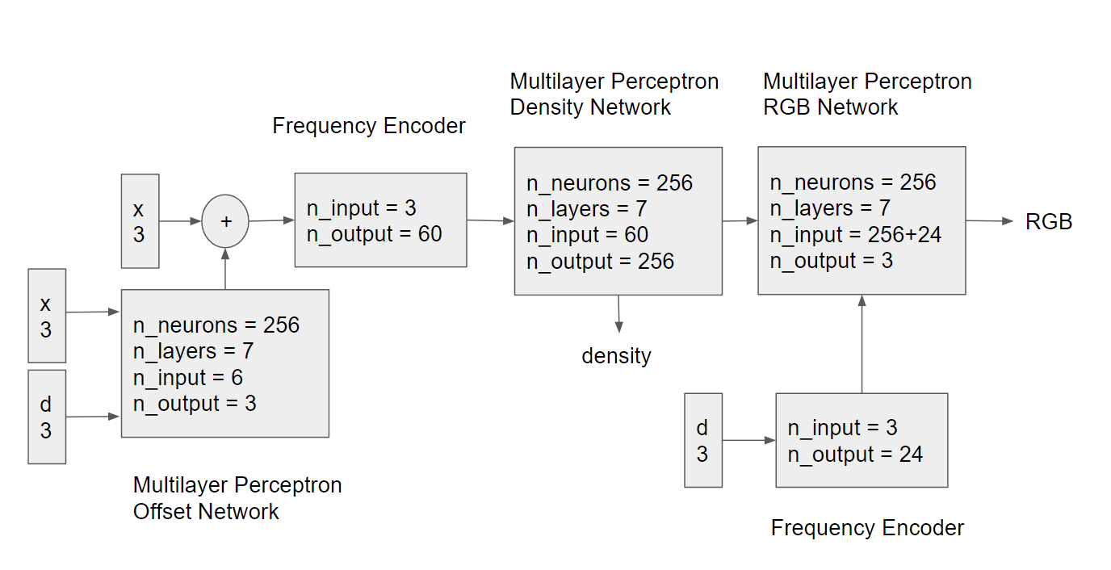
Network Architecture

Slide 4
Training
Input of position is normalized, range from -1 to 1
Position is still small without normalization
Offset field can predict offsets like 10 or 100, totally mess up the training
Tanh activation restricts the offset in [-1, 1]
Tanh makes the training harder, offset field becomes all zeros
Conditionally regularize the offset
Use L1 regularization to create sparse offset field

Slide 5
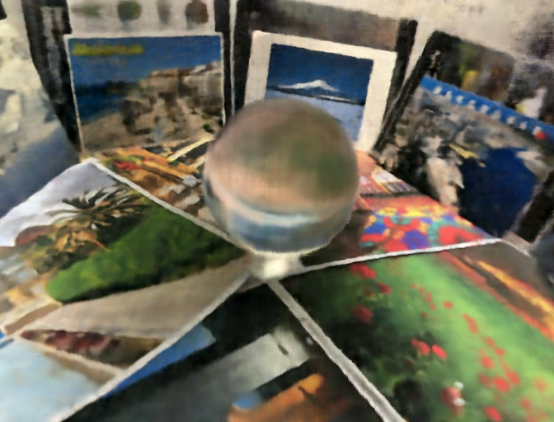
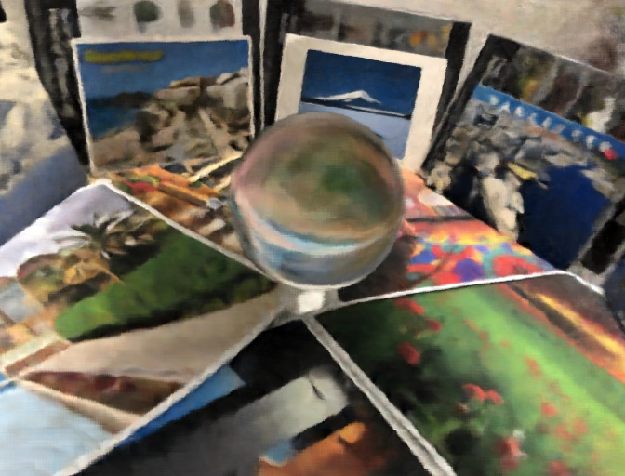
Results
NeRF
LB-NeRF

Slide 6

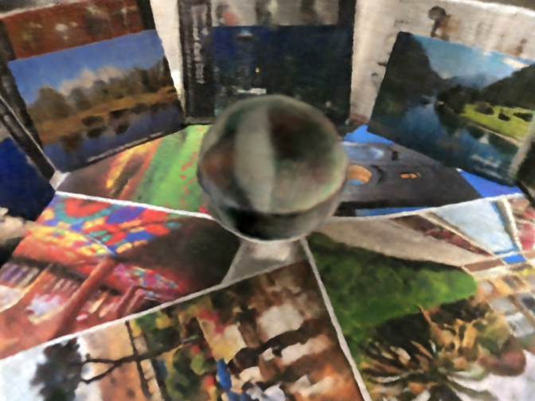
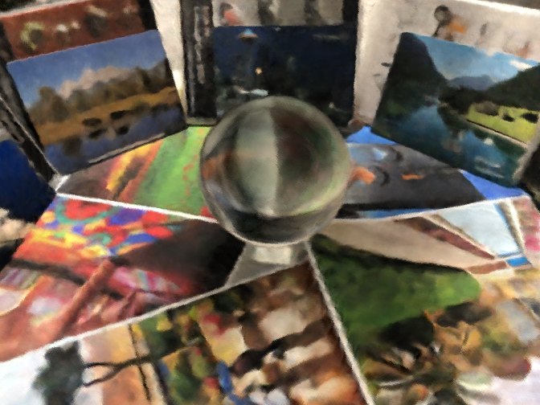

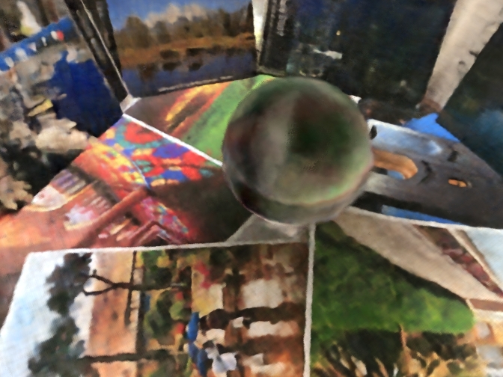
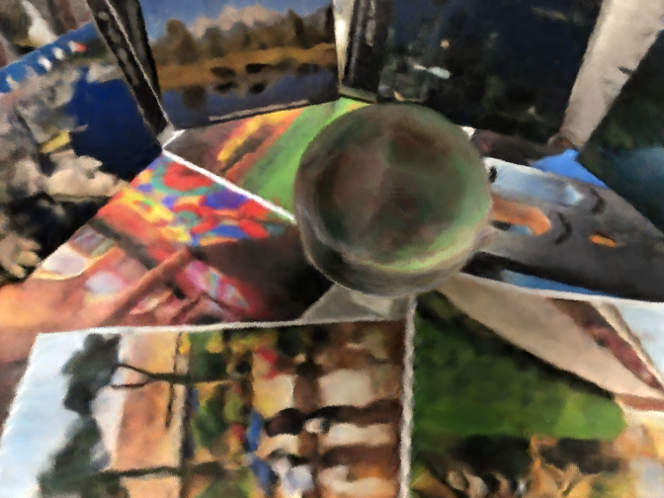
Results
reference
NeRF
LB-NeRF

Slide 7
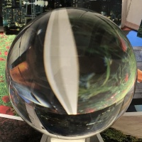
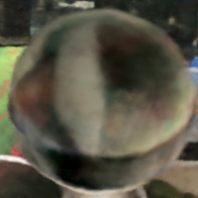
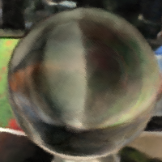
Results
reference
NeRF
LB-NeRF
MS-SSIM = 1
MS-SSIM = 0.5163
MS-SSIM = 0.5908

Slide 8


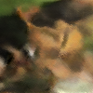
Results
reference
NeRF
LB-NeRF
MS-SSIM = 1
MS-SSIM = 0.6298
MS-SSIM = 0.5537

